Slide 1
  Imperialism in Africa
Europe’s lasting effects upon the Continent

Slide 2
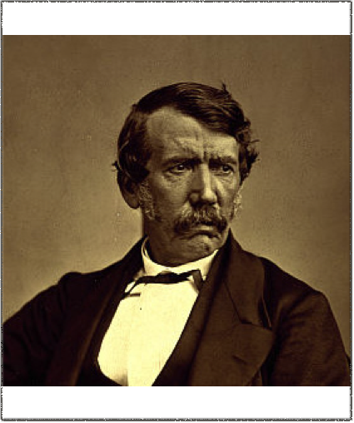
Where do we get the needed raw materials?
Europe decided to take them from Africa
They sent explorers to find goods and partitioned lands for their own use

Slide 3
Fighting Over Land
King Leopold of Belgium took the dominant role in partitioning Africa by exploiting the Congo
The British were occupying Egypt
The British and French were competing over trade along the Niger River

Slide 4
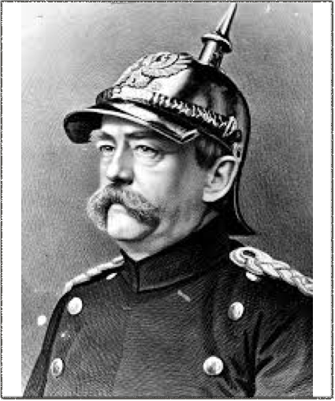
Otto von Bismarck
These European countries being “involved” in Africa worried German leader Otto von Bismarck
Bismarck convened the Berlin Conference in 1884

Slide 5
Berlin Conference
The major western powers met in 1884 to negotiate questions and end confusion over the control of Africa
It also gave Bismarck a chance to expand Germany’s sphere of influence in Africa
At the time of the conference, 80% of Africa remained under traditional and local control

Slide 6
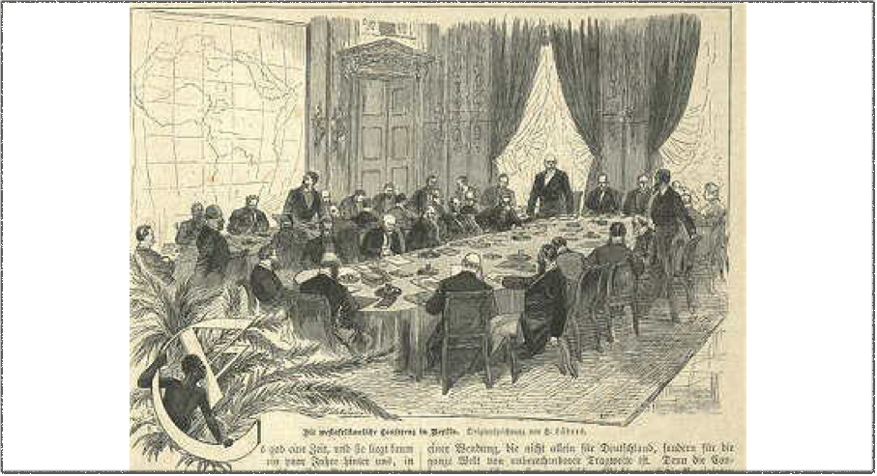
  Berlin Conference
Berlin, Germany 1884

Slide 7
Berlin Conference
Over a series of meetings, it was decided how Africa’s land was to be divided
No African rulers were in attendance
European rivals agreed to stay out of each other’s sphere of influence

Slide 8
Positive Effects for Africa
Schools and hospitals built
Economy was improved by new governments
Roads and railroads were built
Health was improved
Berlin Conference set an end date to the slave trade
New technology elevated the standard of living

Slide 9
Negative Effects
African communities lost control of their own lands
Land was confiscated for farms for the European countries
Wars, revolts, and protests were common
Starvation and disease became widespread
“New Borders” were drawn that separated families and cultural groups
Conflicts broke out between groups and communities that were once friendly

Slide 10
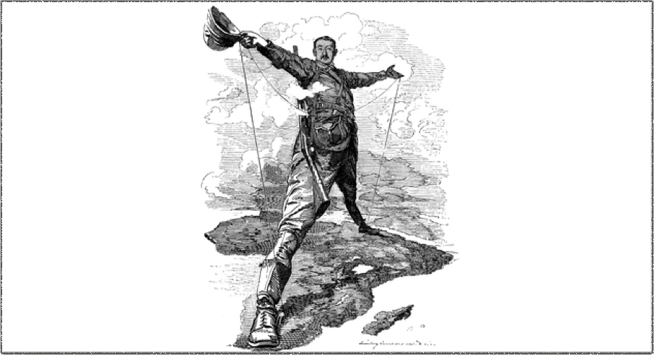
The Rhodes Colossus
What does this image say to you?

Slide 11
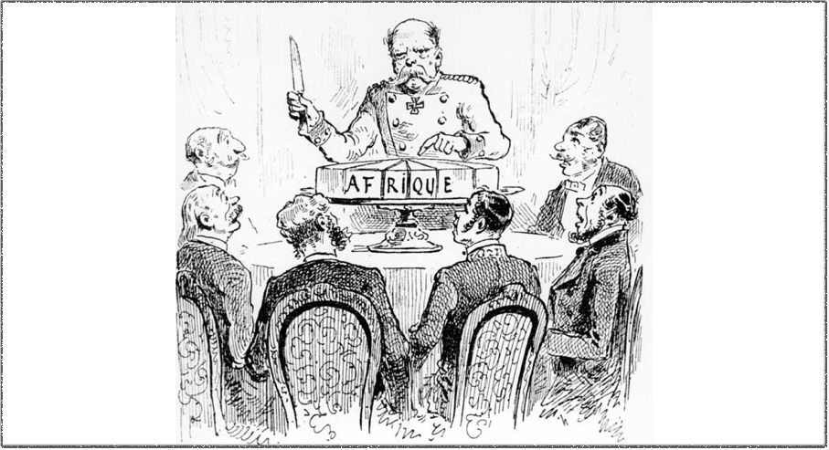
The Berlin Conference
What does this image say to you?

Slide 12
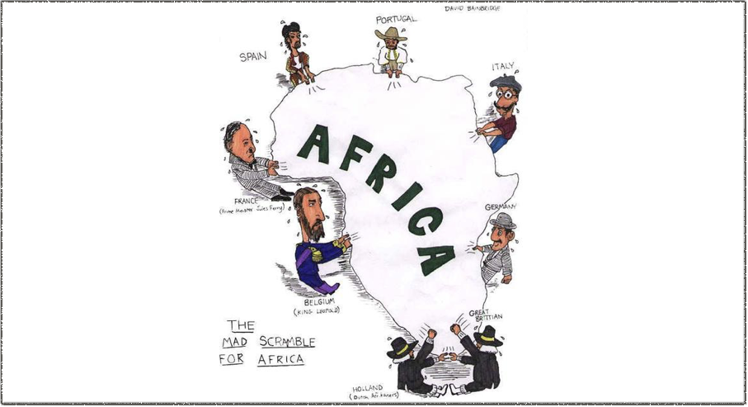
The Mad Scramble
What does this image say to you?

Slide 13
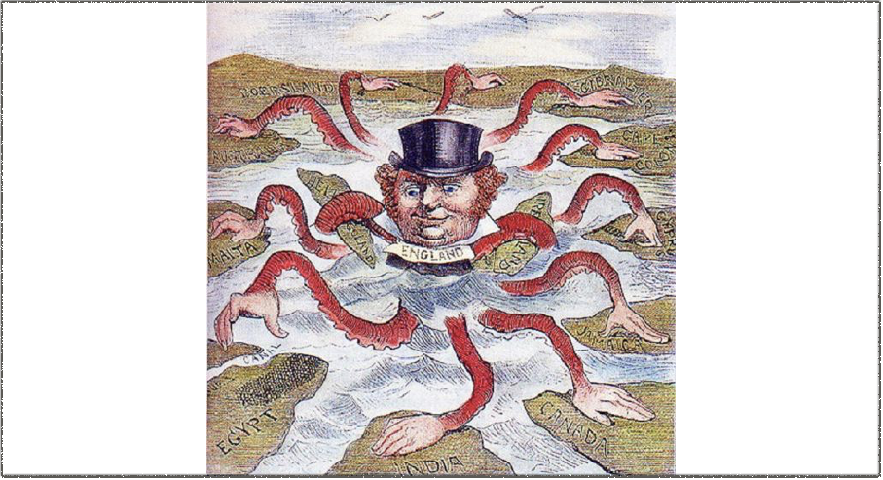
The Arms of an Empire
What does this image say to you?

Slide 14
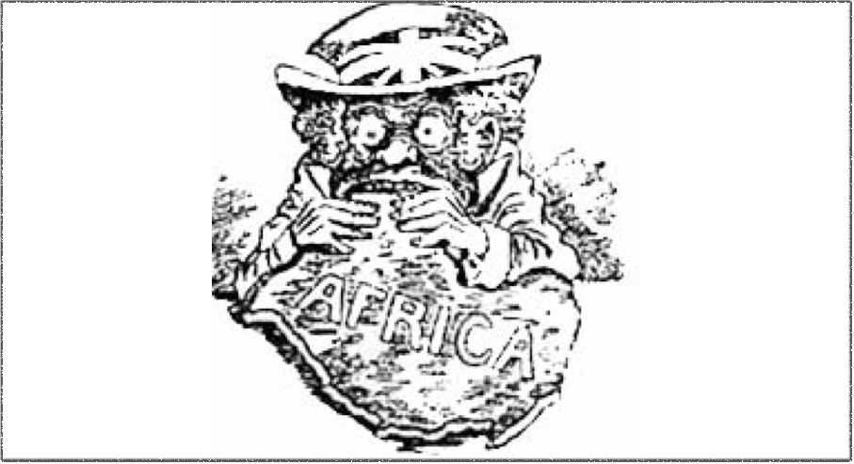
British Imperialism
What does this image say to you?

