Slide 1

Southwest Asia
(Middle East) Water
#5

Slide 2
South West Asia Climate
Southwest Asia is hot and dry
That means water is going to be a very important resource.
It’s all the more important as the population continues to increase.
Notes:
Climate is weather long term.

Slide 3
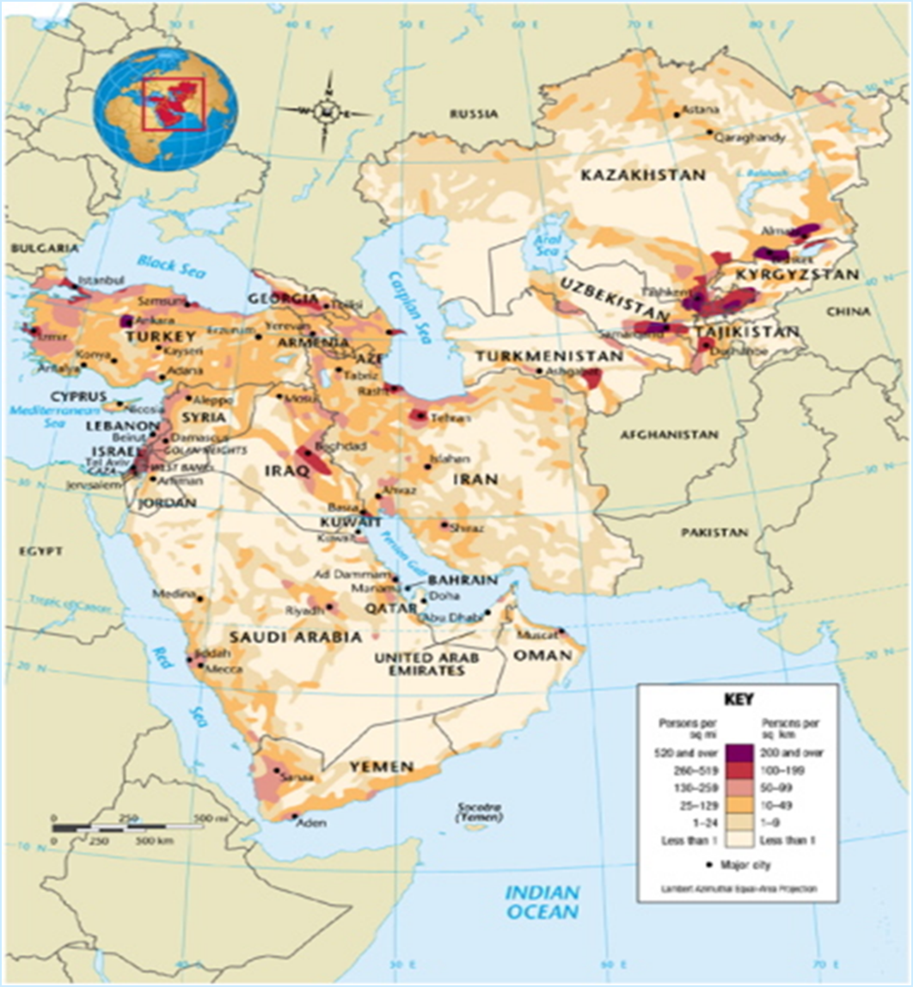
Population Density
- What could looking at a population density map tell us?
Notes:
Where water is. (people want to live close to water sources)
Where major cities are (technological advancements)

Slide 4
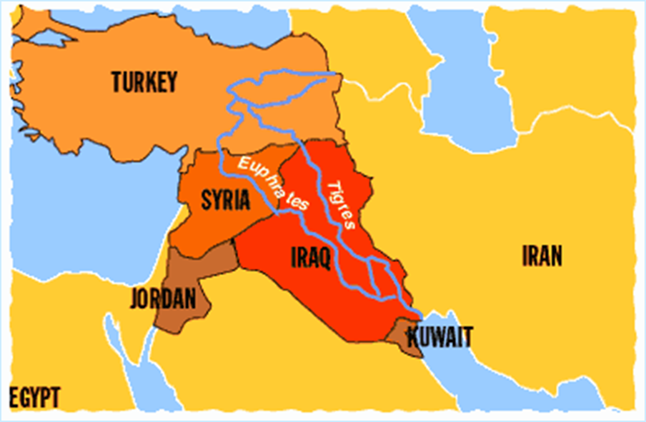
Divert: disrupt the natural flow
Dams and irrigation systems divert the few rivers that exist in the region. The dams can also be used to produce hydroelectricity.
Turkey and Iraq have dams on the Euphrates River.
Israel has dams on the Jordan.
Both divert water for irrigation.
Notes:
Write the definition of ‘divert’ on the margin on the notes sheet.

Slide 5
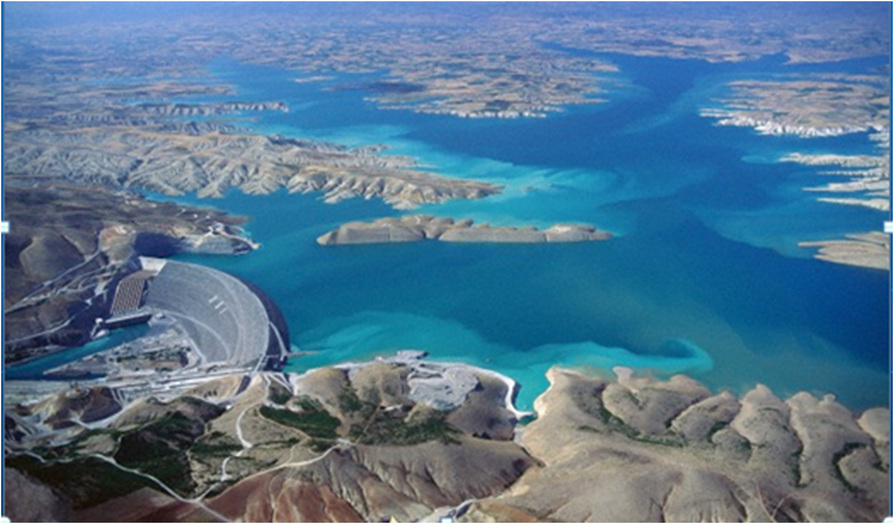
Ataturk Dam
Notes:
On the Euphrates River in Turkey

Slide 6
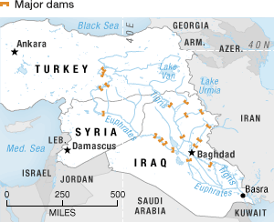
Orange represents dams on the rivers.
Notes:
The Euphrates & the Tigris both flow from Turkey, with Turkey controlling the most & freshest/ cleanest water. As it works it’s way down to the Persian Gulf, countries are able to store less & less water because of the dams present in the previous countires.

Slide 7
The downside of dams and irrigation techniques is that they disrupt the river ecosystems.
Land along the Tigris and Euphrates river depends on periodic flooding, but that doesn’t happen with dams.
http://www.dameffects.org/index.html
Notes:
https://www.washingtonpost.com/news/energy-environment/wp/2016/03/18/why-dams-are-such-bad-news-for-the-amazon-rainforest/?utm_term=.37ef0993a5ee

Slide 8
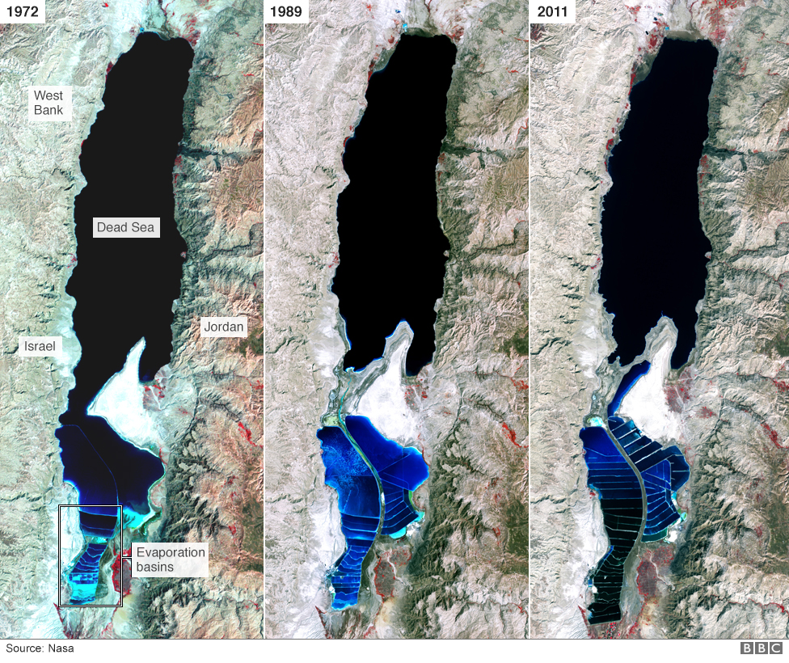
The Dead Sea is fed by the Jordan River, but today only about 10% of the Jordan’s discharge gets to it. This has caused the Dead Sea’s depth to decrease significantly.
Notes:
http://www.bbc.com/news/world-middle-east-36477284

Slide 9
Modern Methods of Irrigation
Drip irrigation
This is a low water consumption form of
irrigation.
Instead of just spraying water all over the place, most of which evaporates as it is sprayed on plants and never actually gets to the soil, these systems drip water just above the ground.
How you water your crops

Slide 10
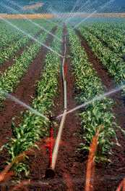
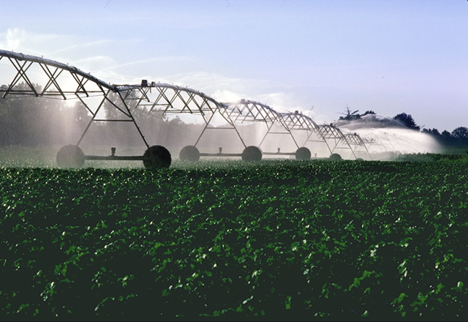
Wasteful

Slide 11
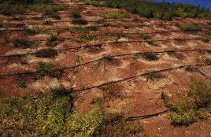
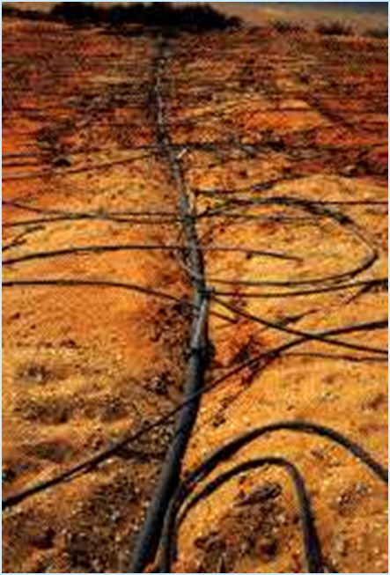
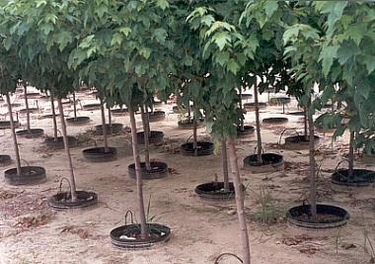
Efficient
Notes:
https://www.youtube.com/watch?v=FqHXdtyM3yo

Slide 12
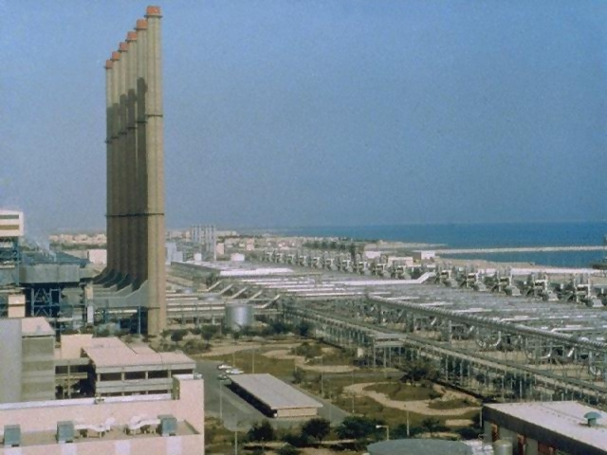
Desalination Plants
These are plants along the coast that remove the salt from ocean water.
Desalination plant in Saudi Arabia
Notes:
https://www.youtube.com/user/Timcasts?v=NnPQiqzOQPE

Slide 13
Desalinated water isn’t always fit for drinking, but can be depending on the process.
Desalination is also very expensive and will produce waste that needs to be disposed.
Some desalination plants can produce 25 million gallons of fresh water per day or more.
There are also desalination plants in the U.S. Tampa Bay has one and San Antonio has proposed building one on the gulf with a pipeline to the city.

Slide 14

Fossil Water
This process pumps underground well water from aquifers.
This is water that has been pooled there for a long time, however, and isn’t replenished by underground springs, rivers, or rainfall – hence the ‘fossil’ part.

Slide 15
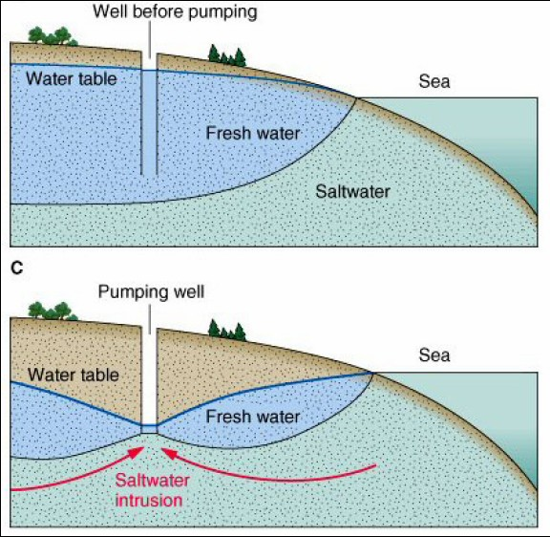
The other problem is that salt water will start getting into the well and make it brackish.
Notes:
slightly salty, as is the mixture of river water and seawater in estuaries.

Slide 16
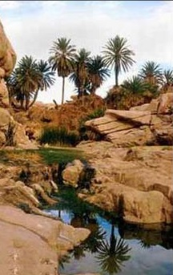
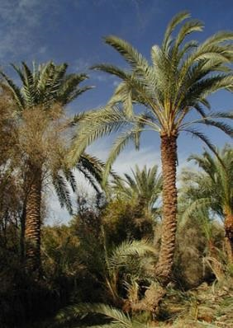
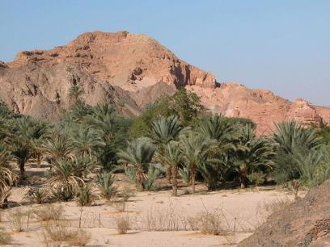
Desert Oases

Slide 17
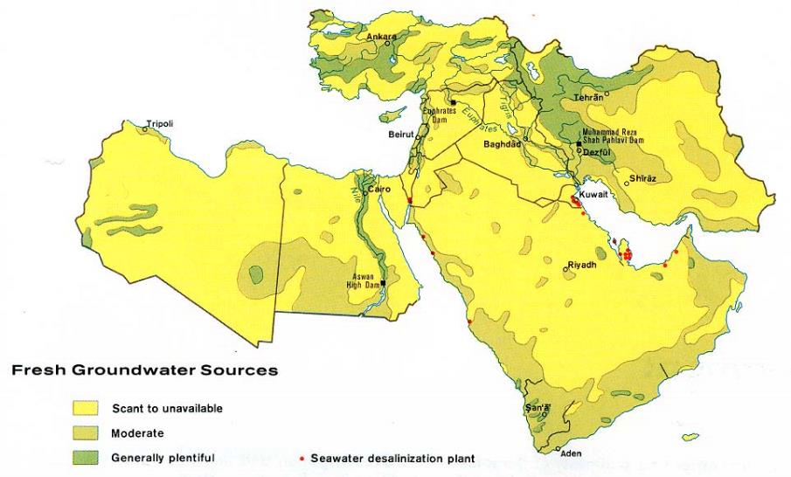
Fresh Groundwater Sources

Slide 18
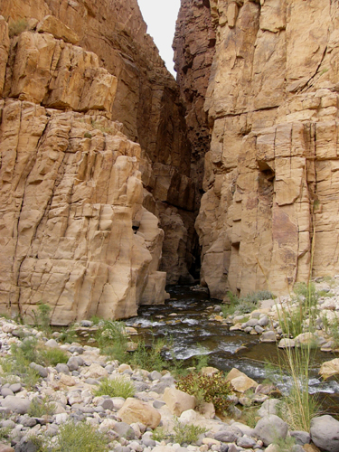
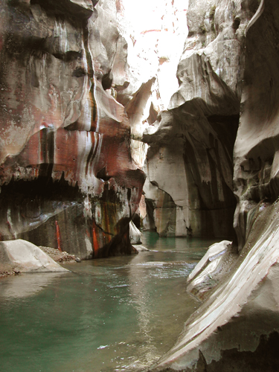
Wadis- Instant Springs

Slide 19
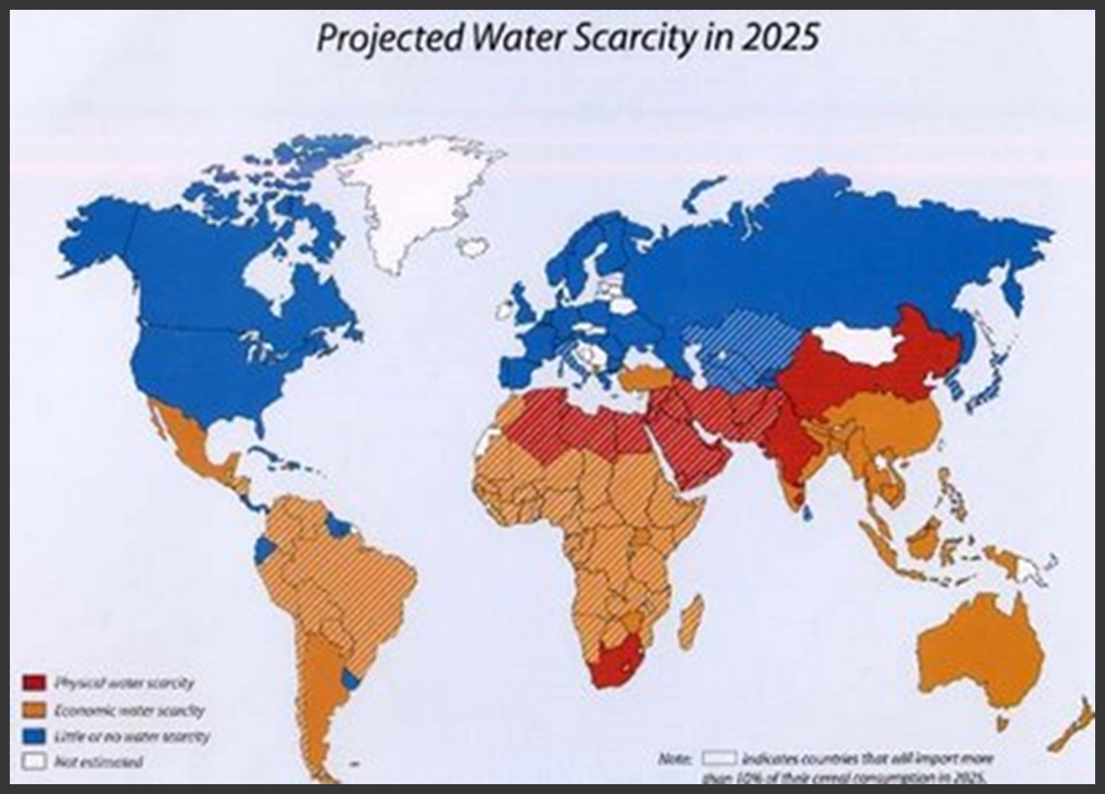

Slide 20
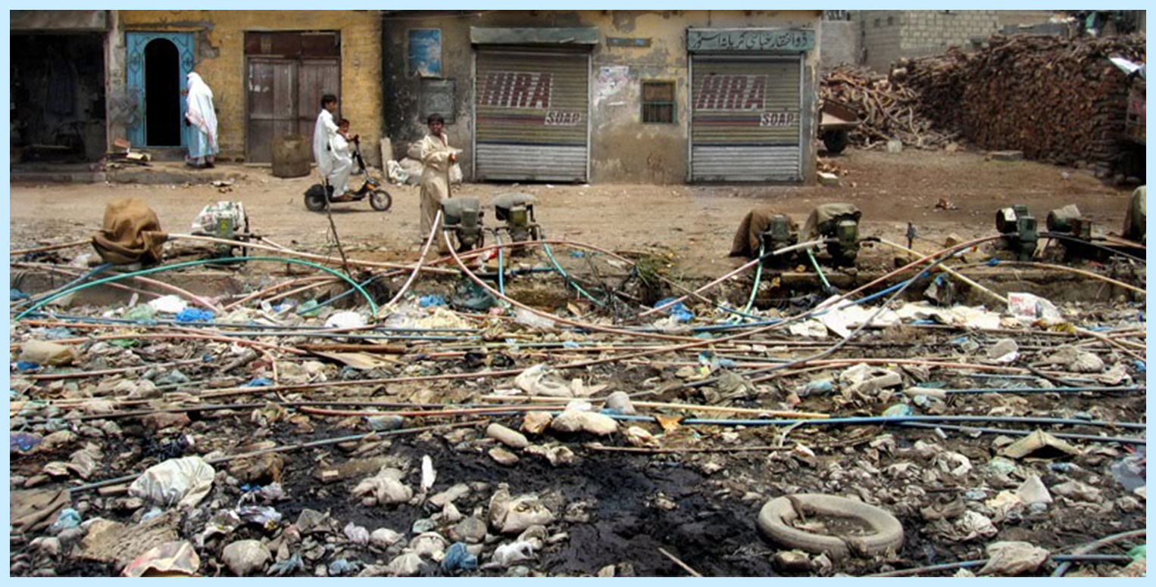
Water Pollution

Slide 21
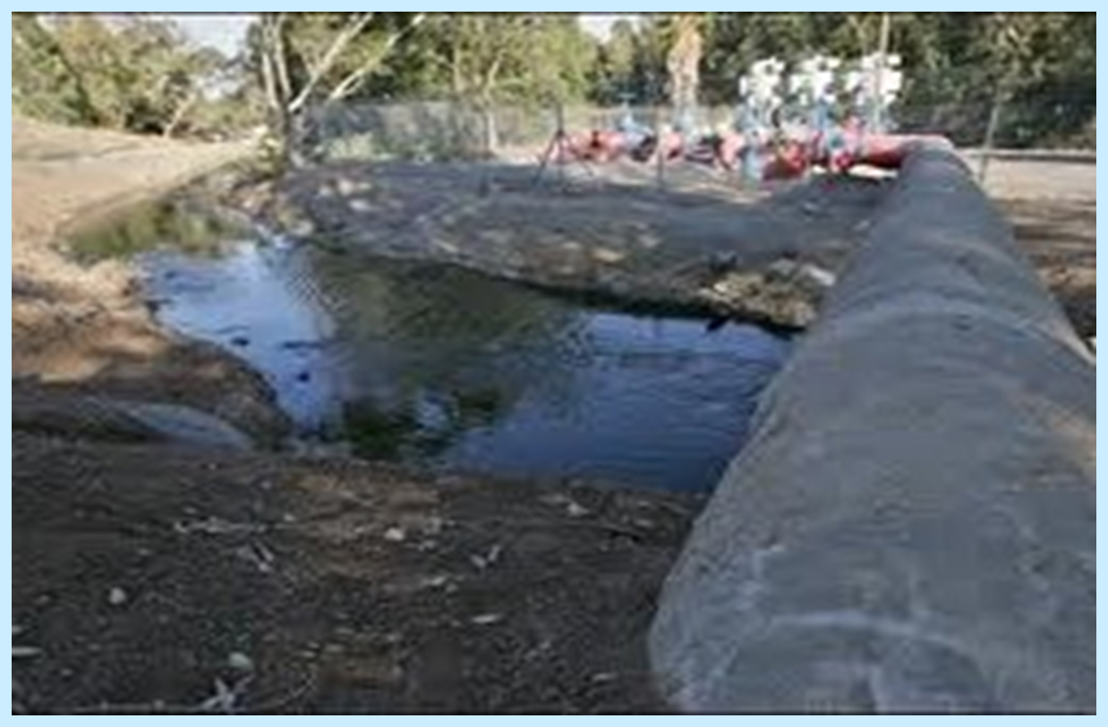
A section of the Alumot dam where sewage is pumped into the Jordan

Slide 22
Many farmers have begun to use chemical fertilizers, which have contaminated water supplies through runoff into the rivers and streams.
Constant planting and fertilizer use have led to the build-up of salt levels in soils, eventually making it impossible to farm in those areas.
In the rush to develop industry, many cities and towns have grown rapidly, but the people living there have been slow to create effective ways to manage garbage and treat sewage.

