Slide 1
Environmental Issues
Your goal is to be able to answer the following 3 questions:
SS7G2: Explain environmental issues across the continent of Africa.
Explain how water pollution and unequal access to water impacts irrigation, trade, industry, and drinking water.
Explain the relationship between poor soil and deforestation in Sub-Saharan Africa.
Explain the impact of desertification on the environment of Africa.

Slide 2
SS7G2: Explain environmental issues across the continent of Africa.
Explain how water pollution and unequal access to water impacts irrigation, trade, industry, and drinking water.
Explain the relationship between poor soil and deforestation in Sub-Saharan Africa.
Explain the impact of desertification on the environment of Africa.

Slide 3
Explain the impact of desertification on the environment of Africa.
What is it?
  The expansion of desert land
Causes:
  Over-grazing
  Drought
Effects:
  Poverty
  Starvation

Slide 4
Make a flip book with 2 sheets of paper
You should have a cover and 3 tabs
Cover: Environmental Issues
1st Tab: Deforestation
2nd Tab: Water Crisis
3rd Tab: Desertification
Go through the following slides & videos & gather the MOST IMPORTANT information from them.
REMEMBER: your goal is to be able to answer the three questions on the board & on the first slide of this PowerPoint, so you will want to write down ANYTHING that can help you answer that question fully.

Slide 5
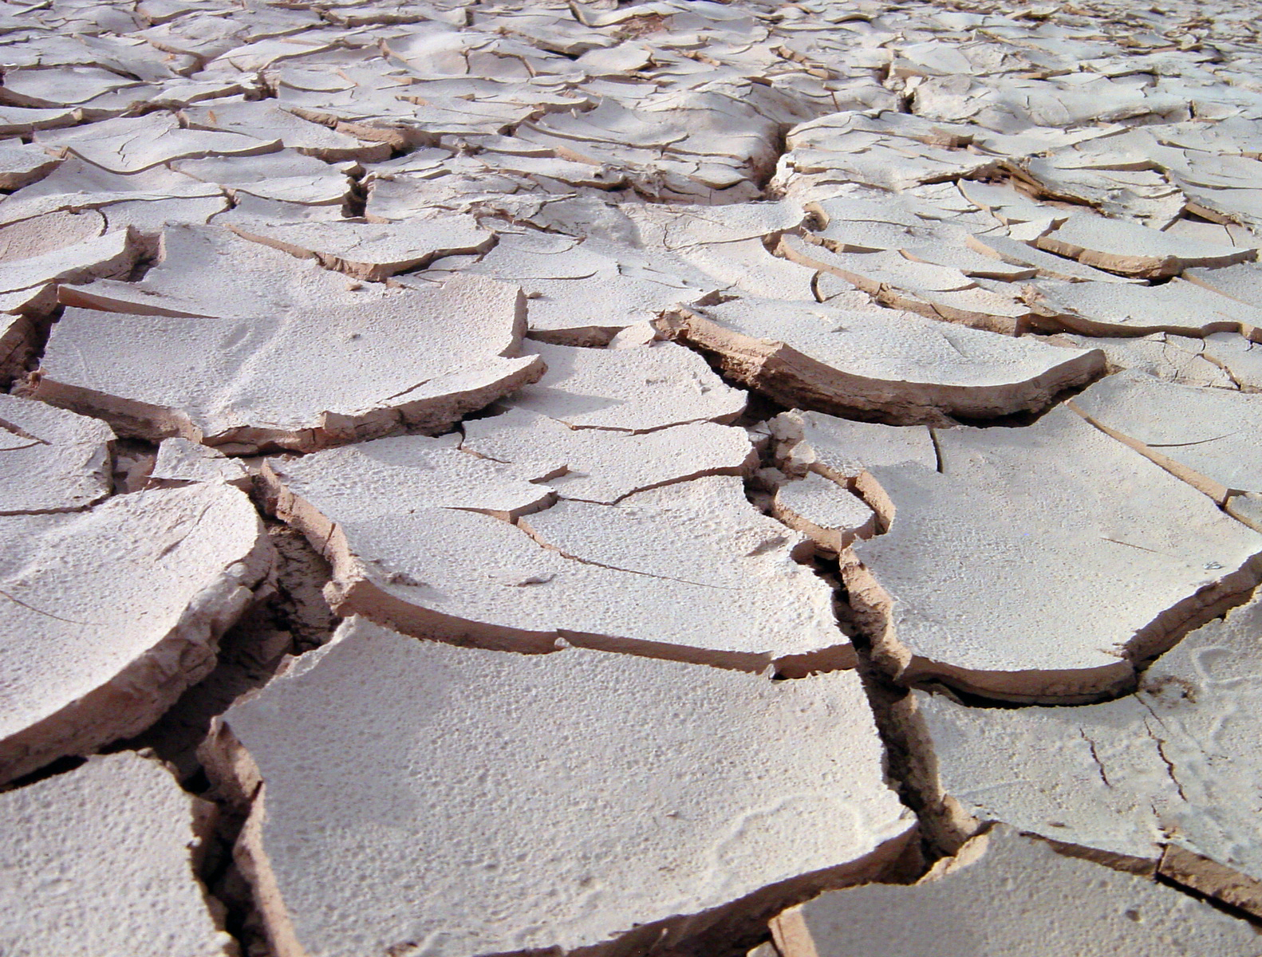
DESERTIFICATION

Slide 6
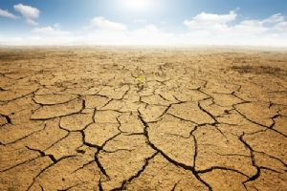
Desertification
The process by which various types of land become desert. In Africa, the overgrazing of animals and severe droughts have led to desertification.
Poor soil leaves the land useless for farming and agriculture
  Increased starvation and poverty

Slide 7
Desertification Causes:
Drought- protracted rainfall failure
Desiccation- long term drought with dry dirt
Human activity- over grazing of farm animals
Soil erosion: soil is a non-renewable resource. It takes thousands of years for good soil to form

Slide 8
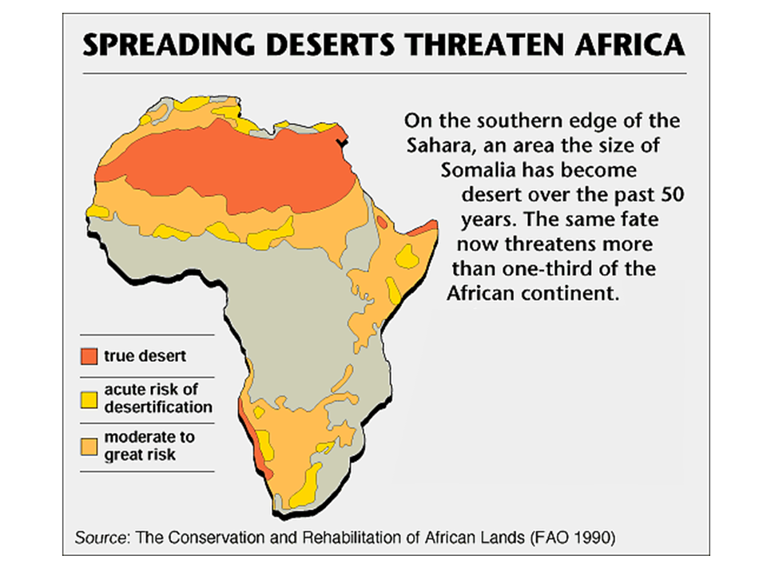
Sahara- is expanding over the last 50 years as a result of human and natural causes

Slide 9
https://www.youtube.com/watch?v=HbqNUC1t1e0
If it will not pull up, try another browser
If it is blocked, move on.
Or you can try searching the name of the video in YouTube
  Is the Earth Turning Into A Big Desert?

Slide 10
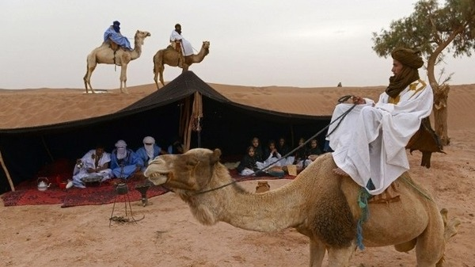
Nomads- living in different locations. Moving from one place to another.
Travel to find water and food for their herds
The most reliable way to get across Africa, CAMEL! ☺

Slide 11
Sahel-
Region of Africa where the most desertification takes place
Poor soil leaves the land useless for farming and agriculture
Subsistence farmers- make enough food for their families
Desertification can also lead to food shortages
This leads to starvation and poverty

Slide 12
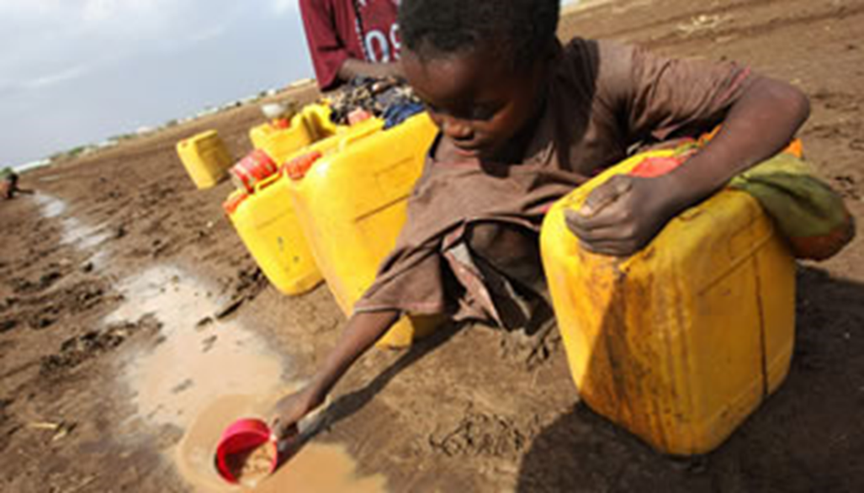
WATER CRISIS

Slide 13
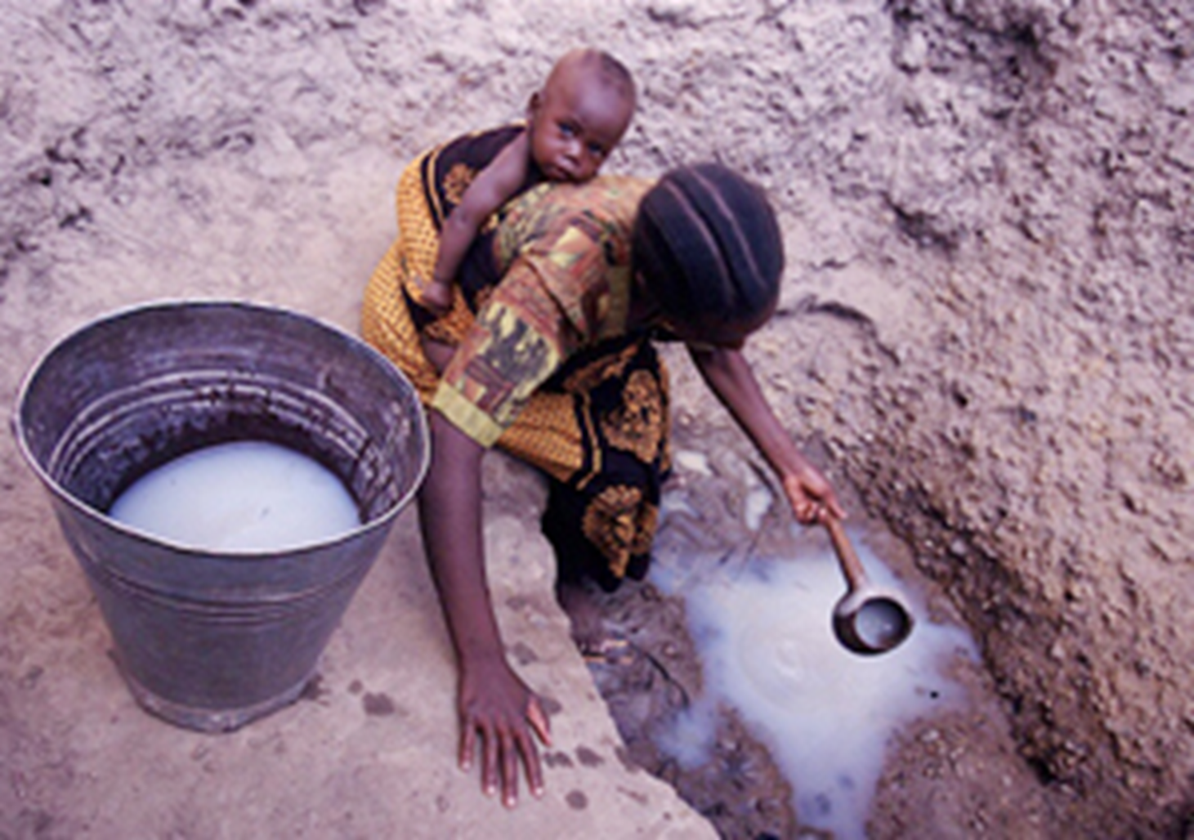

Slide 14
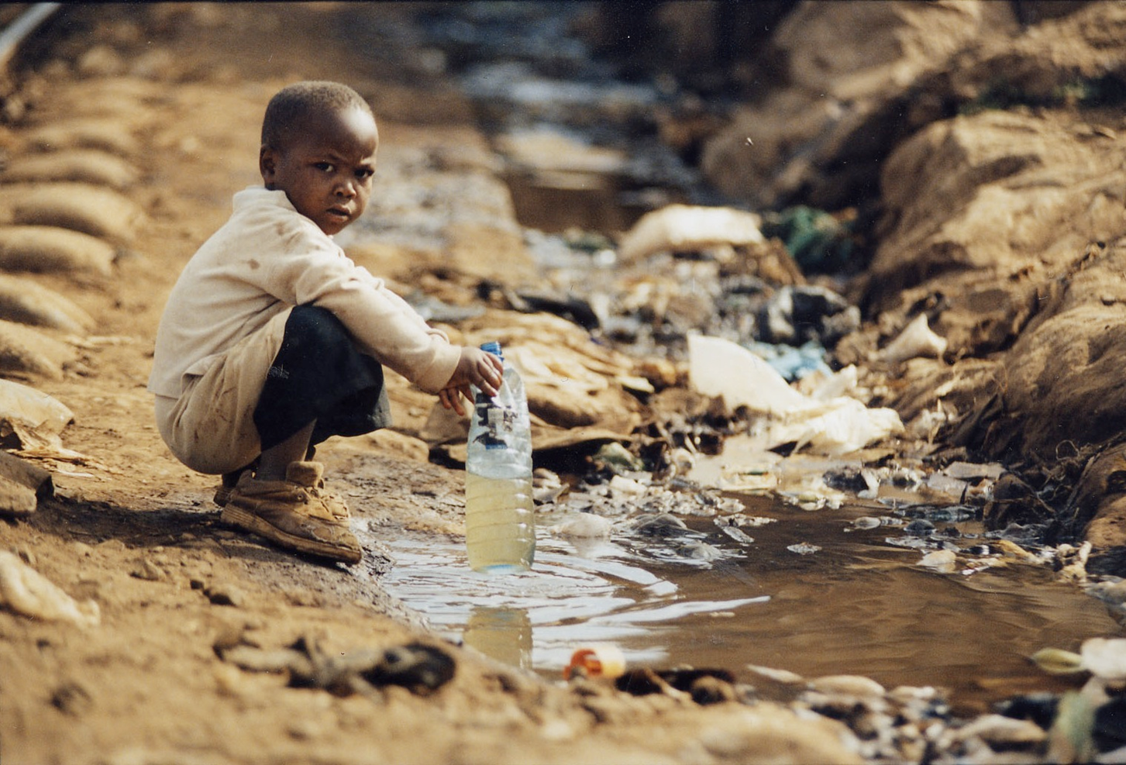

Slide 15
Water Crisis
People may often live too far away from a water source, they have to buy their water from a vendor or supplier. The further away from the source, the more they have to pay.
They pay with…
  Money
  Lives of their children (indentured slavery, essentially)
  Their own lives

Slide 16
In sub-Saharan Africa, less than 50% of the population has access to safe drinking water because of environmental pollution.
Shortage of safe drinking water affects the development of sub-Saharan Africa by slowing the economic growth of the area.

Slide 17
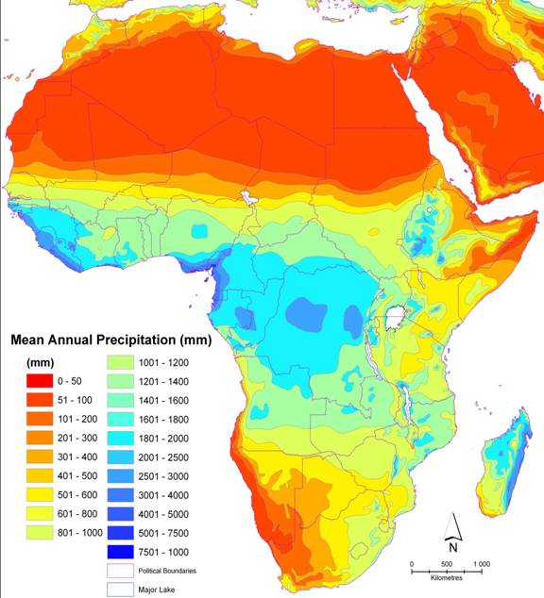
Where does most of the water fall?
Where would you want to live on this continent?

Slide 18
Water Crisis- preventable diseases
Malaria
Guinea worm
River blindness
Schistomioasis
Sleeping sickness
Often times, spread through water.
If people need money to buy clean water, they will go to work even if they are sick. Spreading the disease further.

Slide 19
https://www.youtube.com/watch?v=-bEtqZoD4V4

Slide 20
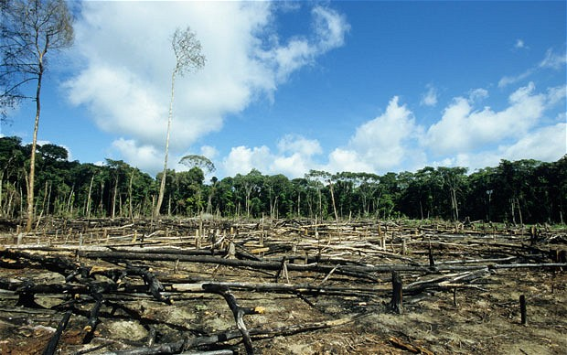
Deforestation

Slide 21
DEFORESTATION
4 major causes:
  1. Agriculture
  2. The logging industry
  3. Fuel wood collection
  4. Cattle ranchers
2 indirect causes:
  1. Poverty
  2. Overpopulation

Slide 22
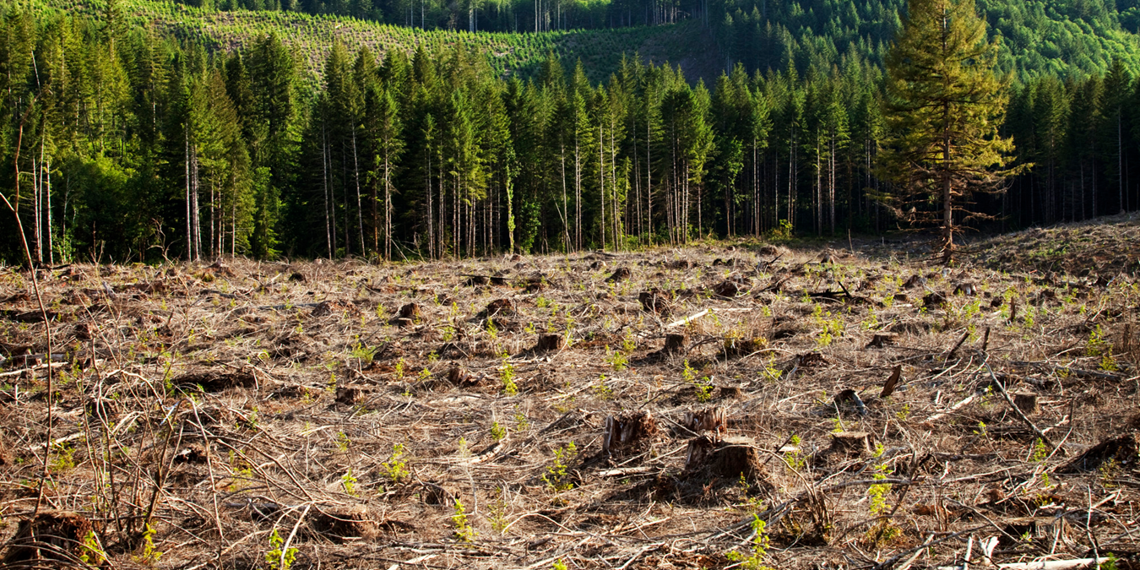

Slide 23
Deforestation
More carbon dioxide is released into the atmosphere. Global warming.

Slide 24
Rainforest
Lost to logging for industry, farming and fuel
Acts as a giant sponge. Absorbs the water and releases it slowly
Heavy flooding and soil erosion, and the siltation (pollution of water through silt or clay)
of rivers are daily occurrences in heavily deforested areas

